Slide 1
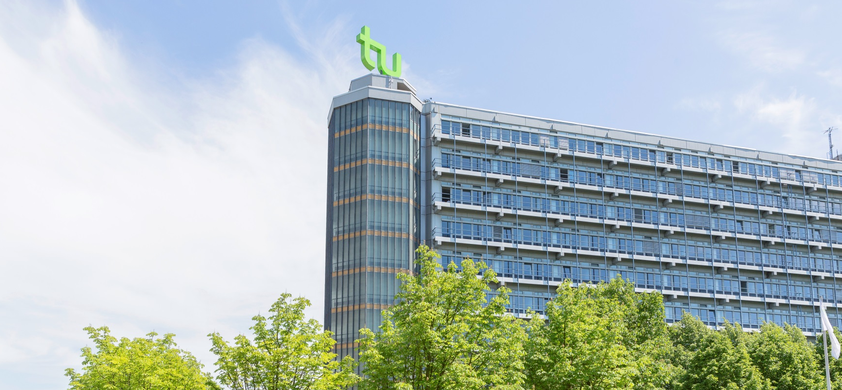
Photo credits: Roland Baege
TU Dortmund University

Slide 2
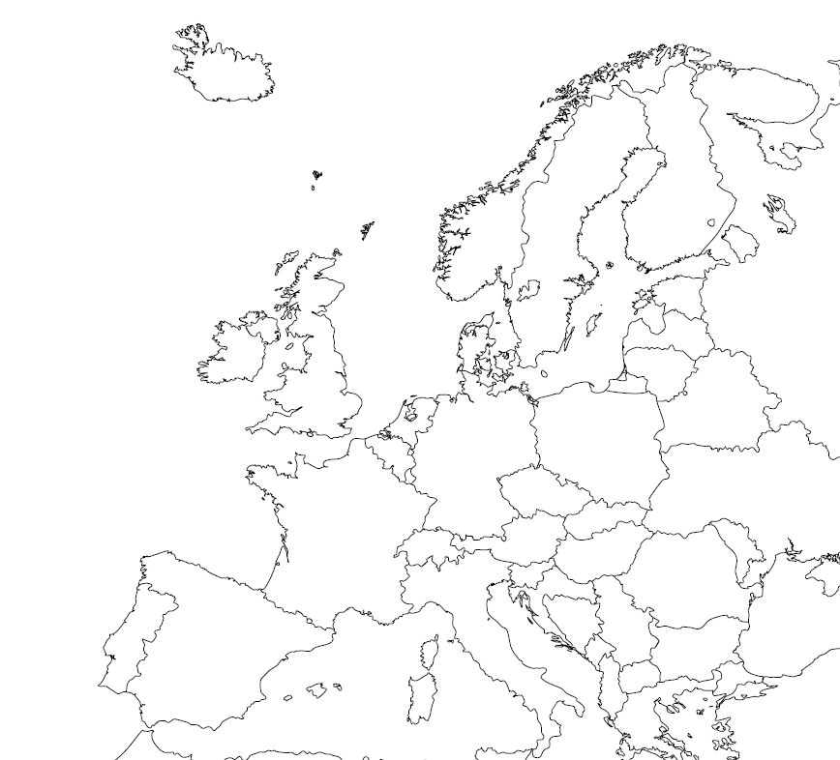
The Ruhr Area is Germany’s most densely populated area with almost 6 million people from over 150 nations
Benefits: safe environment, multicultural, relatively cheap cost of living, great location in Europe
Dortmund has nearly 600,000 inhabitants and a vibrant history
Dortmund

Slide 3
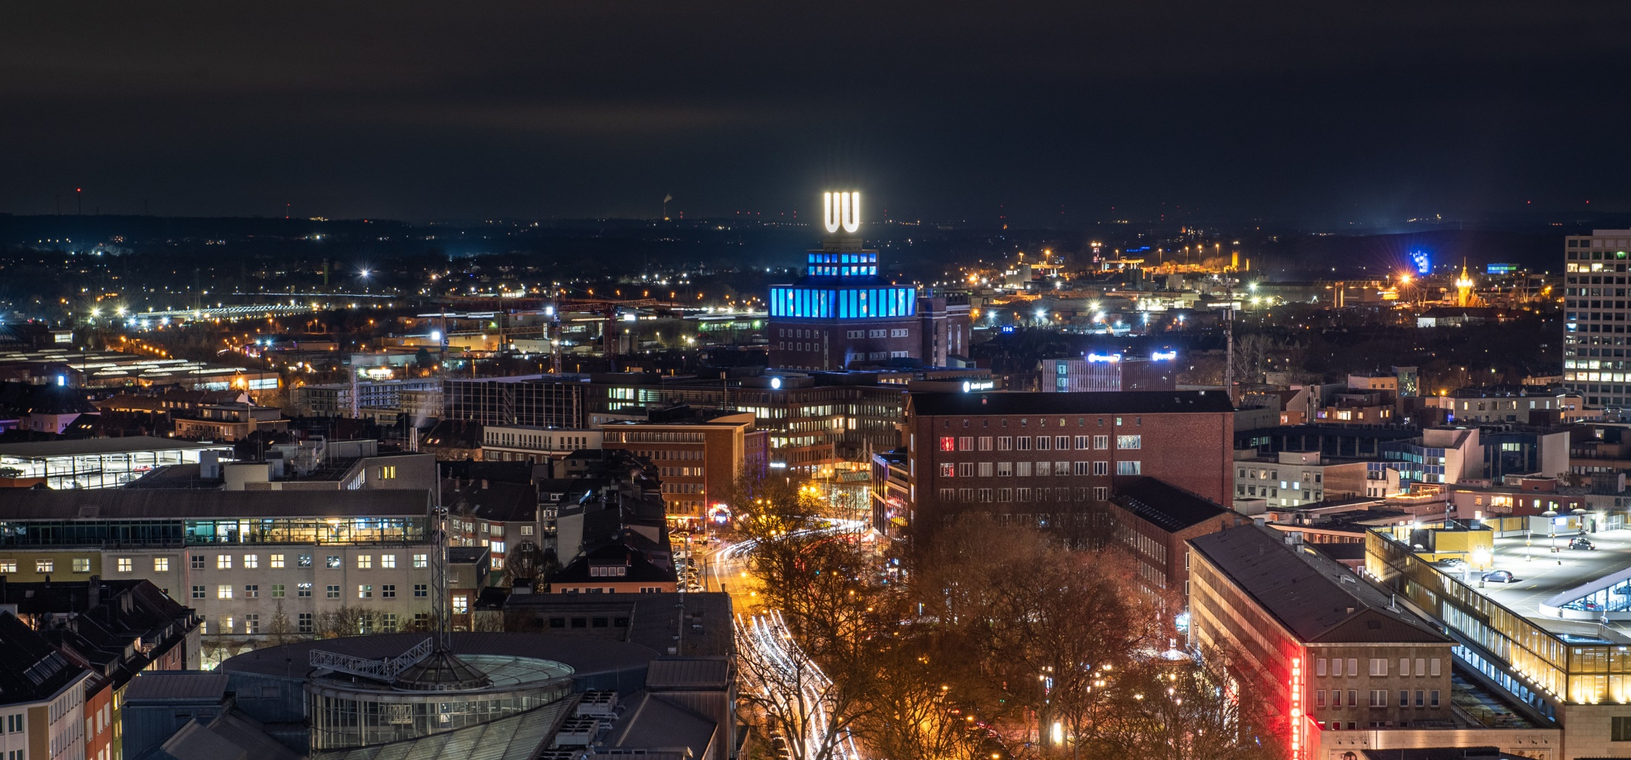
Photo credits: Roland Gorecki
Who are we?
We are Dortmund!

Slide 4
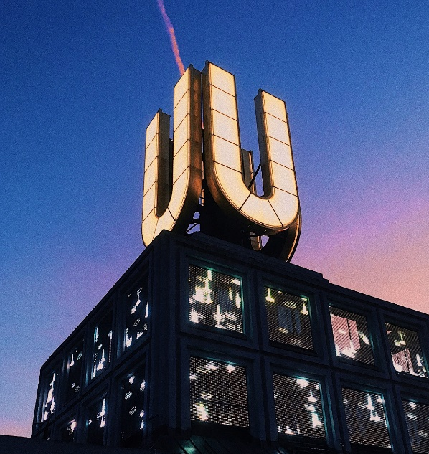
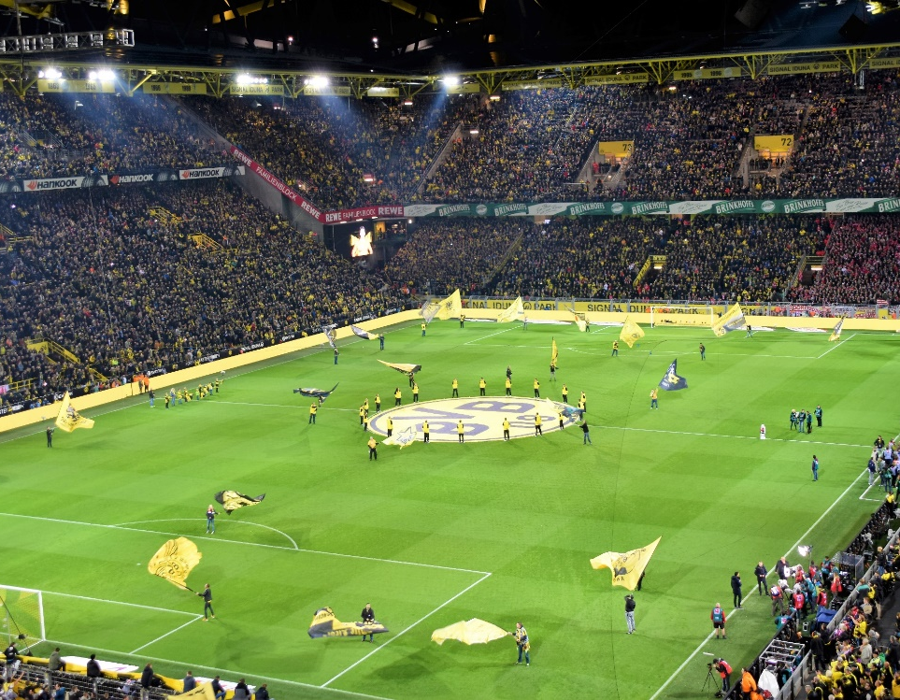
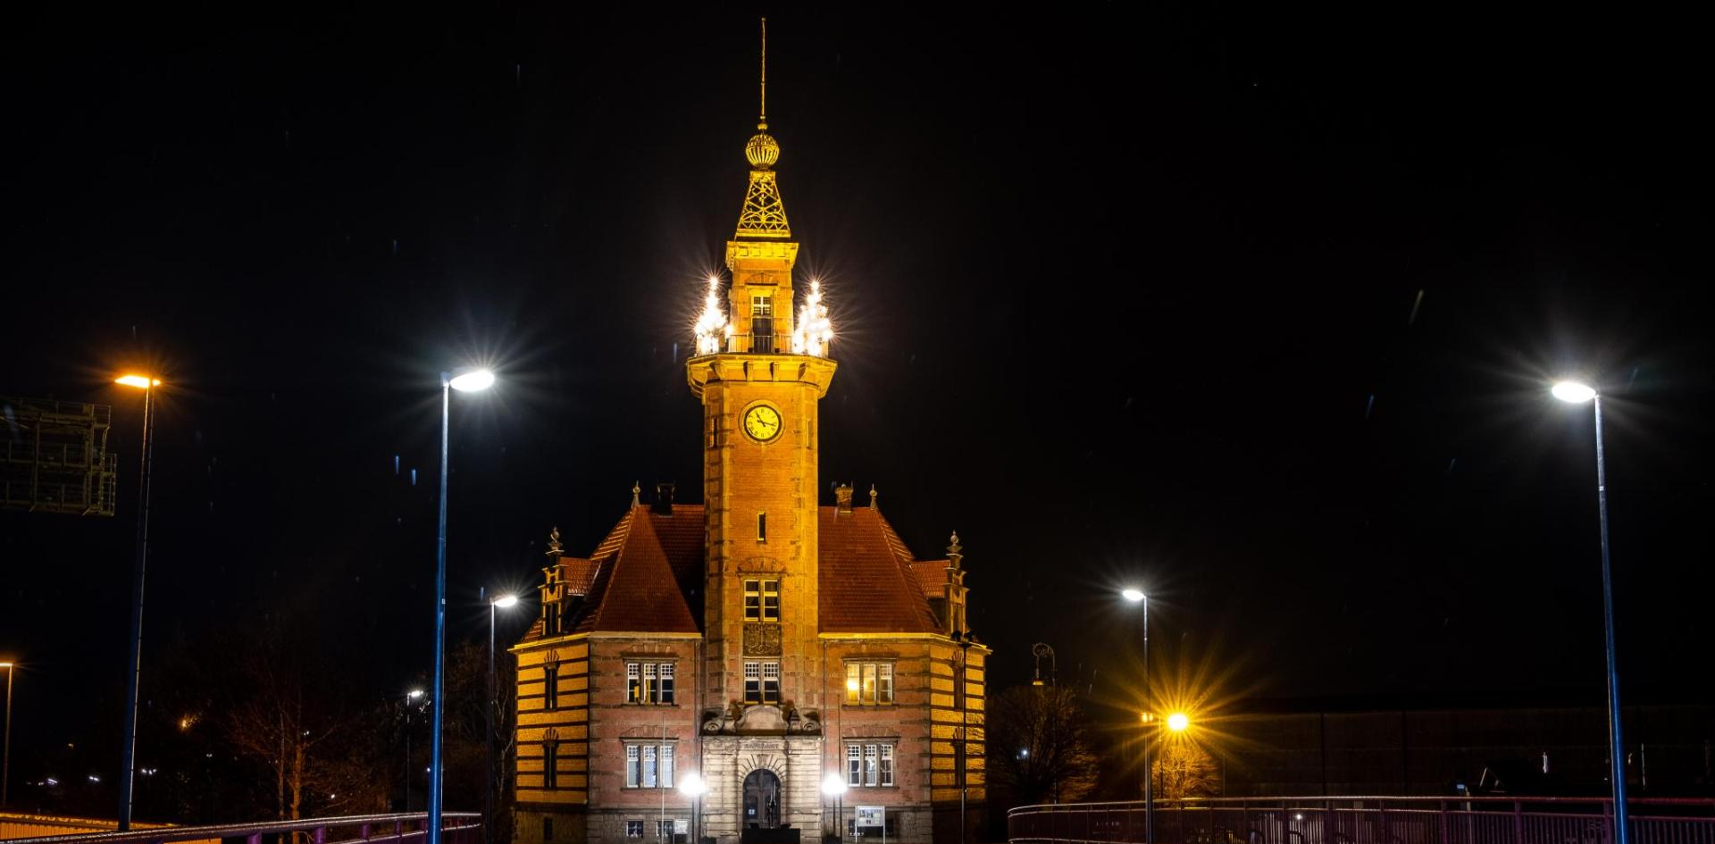
Photo credits: 30daysreplay Germany
Photo credits: Waldemar Brandt
Photo credits: Jonas von Werne
All of this is Dortmund
…and so much more!
Photo credits: Magnus Terhorst
Photo credits: Julian Guttzeit
Photo credits: Evgeni Tcherkasski

Slide 5
Photo credits: Jürgen Huhn
Founded in 1968
Now: approx. 34,000 students, 11% international
2 campuses: Connected by the world’s first fully automatic monorail
Adjacent technology park: the largest in Germany
University Alliance Ruhr: Opportunity to cross-enroll in classes at Ruhr University Bochum and/or at the University of Duisburg-Essen
We are TU Dortmund University with 17 Departments…
Mathematics
Physics
Chemistry & Chemical Biology
Computer Science
Statistics
Biochemical and Chemical Engineering
Mechanical Engineering
Electrical Engineering and Information Technology
Spatial Planning
Architecture and Civil Engineering
Business and Economics
Educational Sciences & Psychology
Rehabilitation Sciences
Humanities & Theology
Cultural Studies
Arts and Sports Sciences
Social Sciences

Slide 6
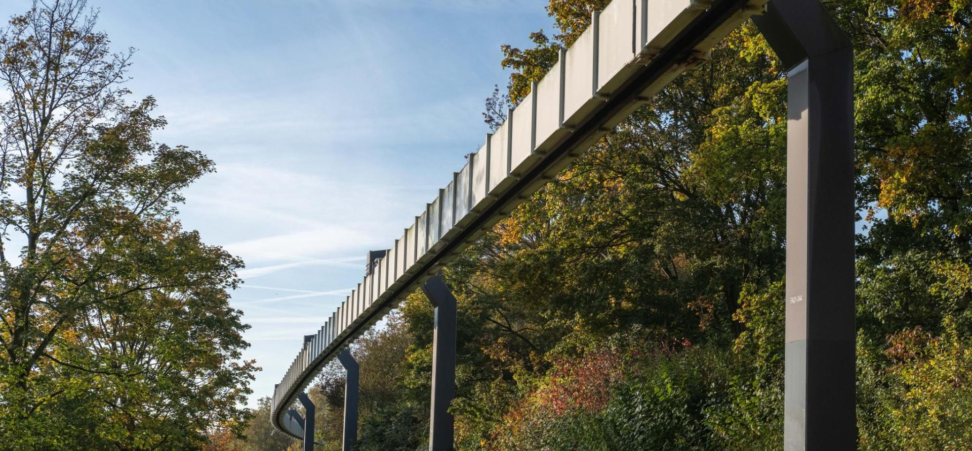
Photo credits: Magnus Terhorst
Services by the International Office
Pre-semester German Intensive Course
4 weeks in March or September, several levels, free of charge for exchange students
Assistance with administrative formalities, e.g.
Enrollment, Health Insurance, Registration at the City of Dortmund
Accommodation Service
Reservation of accommodation on and close to campus possible
Special Needs Services
Special support for students with disabilities or with child(ren)
NRW Ticket
Enables students to use public transport all over North Rhine Westphalia: visit Cologne etc.

Slide 7
Photo credits: Silke Viol
+ Department Services
Academic support from the Departmental Coordinator before, during and after the mobility
Varied course selection
Support around the arrival

Slide 8
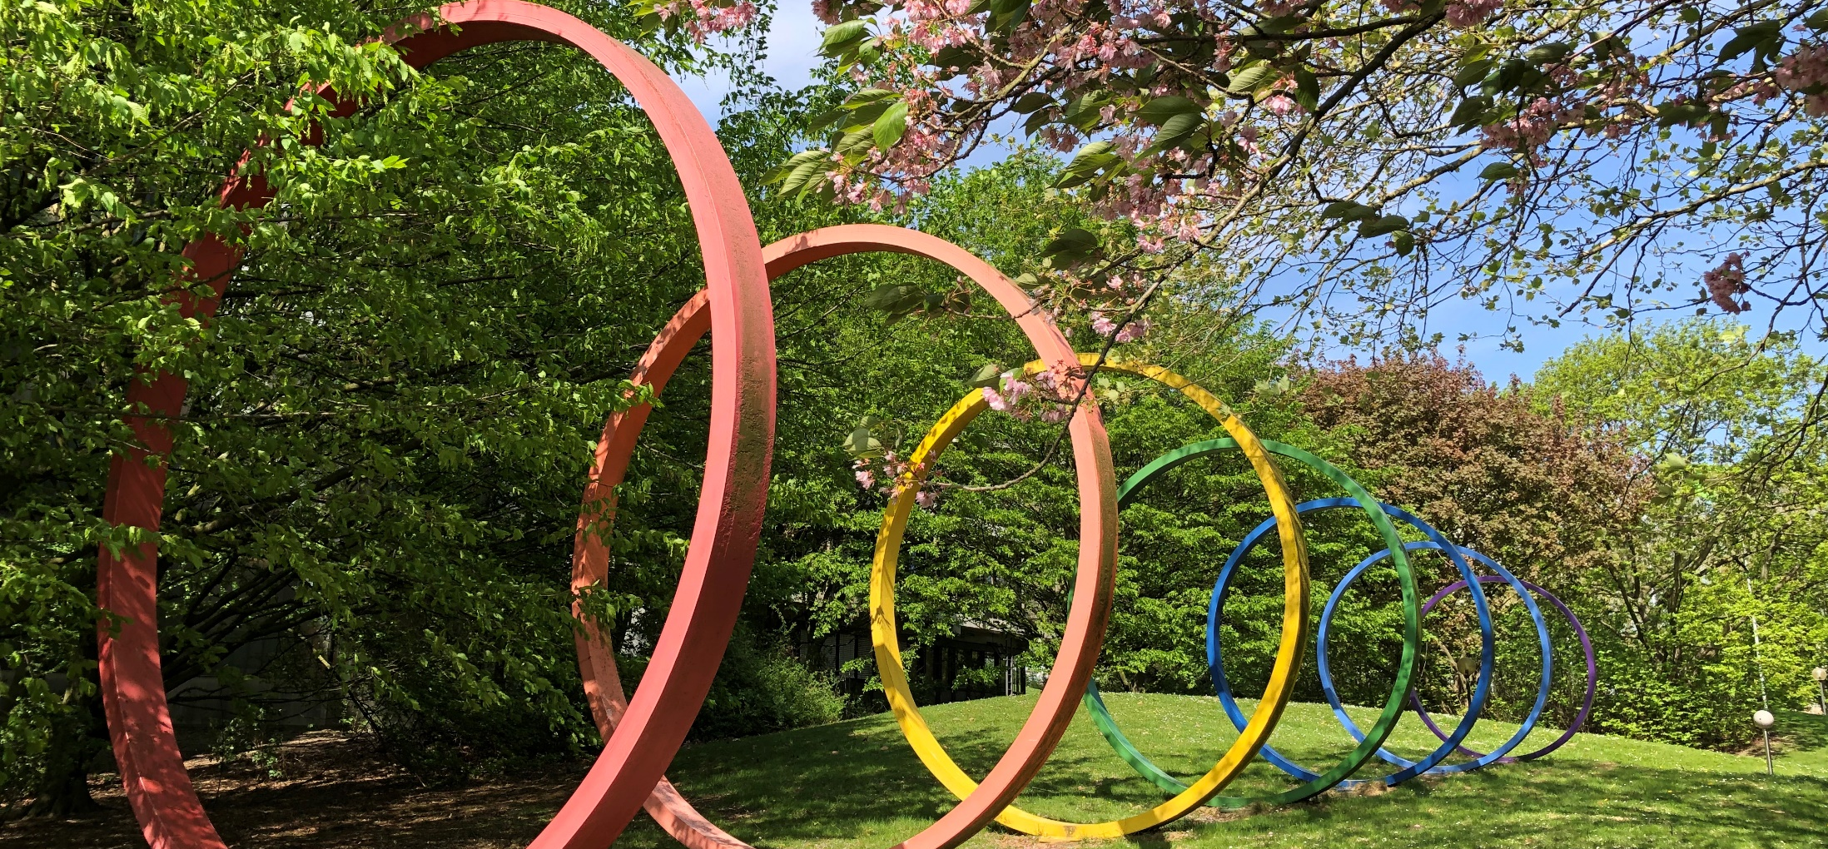
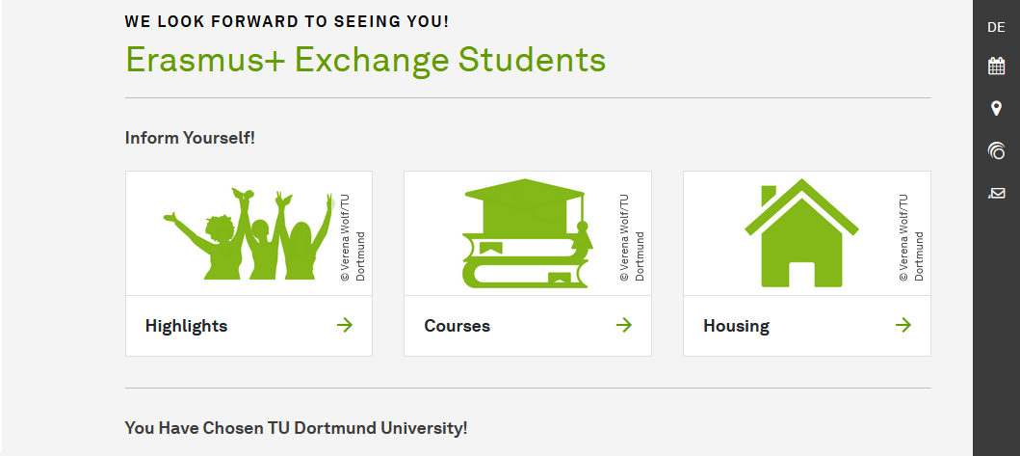
Photo credits: Lea Schubert
New Website in German & English!
All relevant information can be found online (and much more!)
international.tu-dortmund.de/en/erasmus

Slide 9
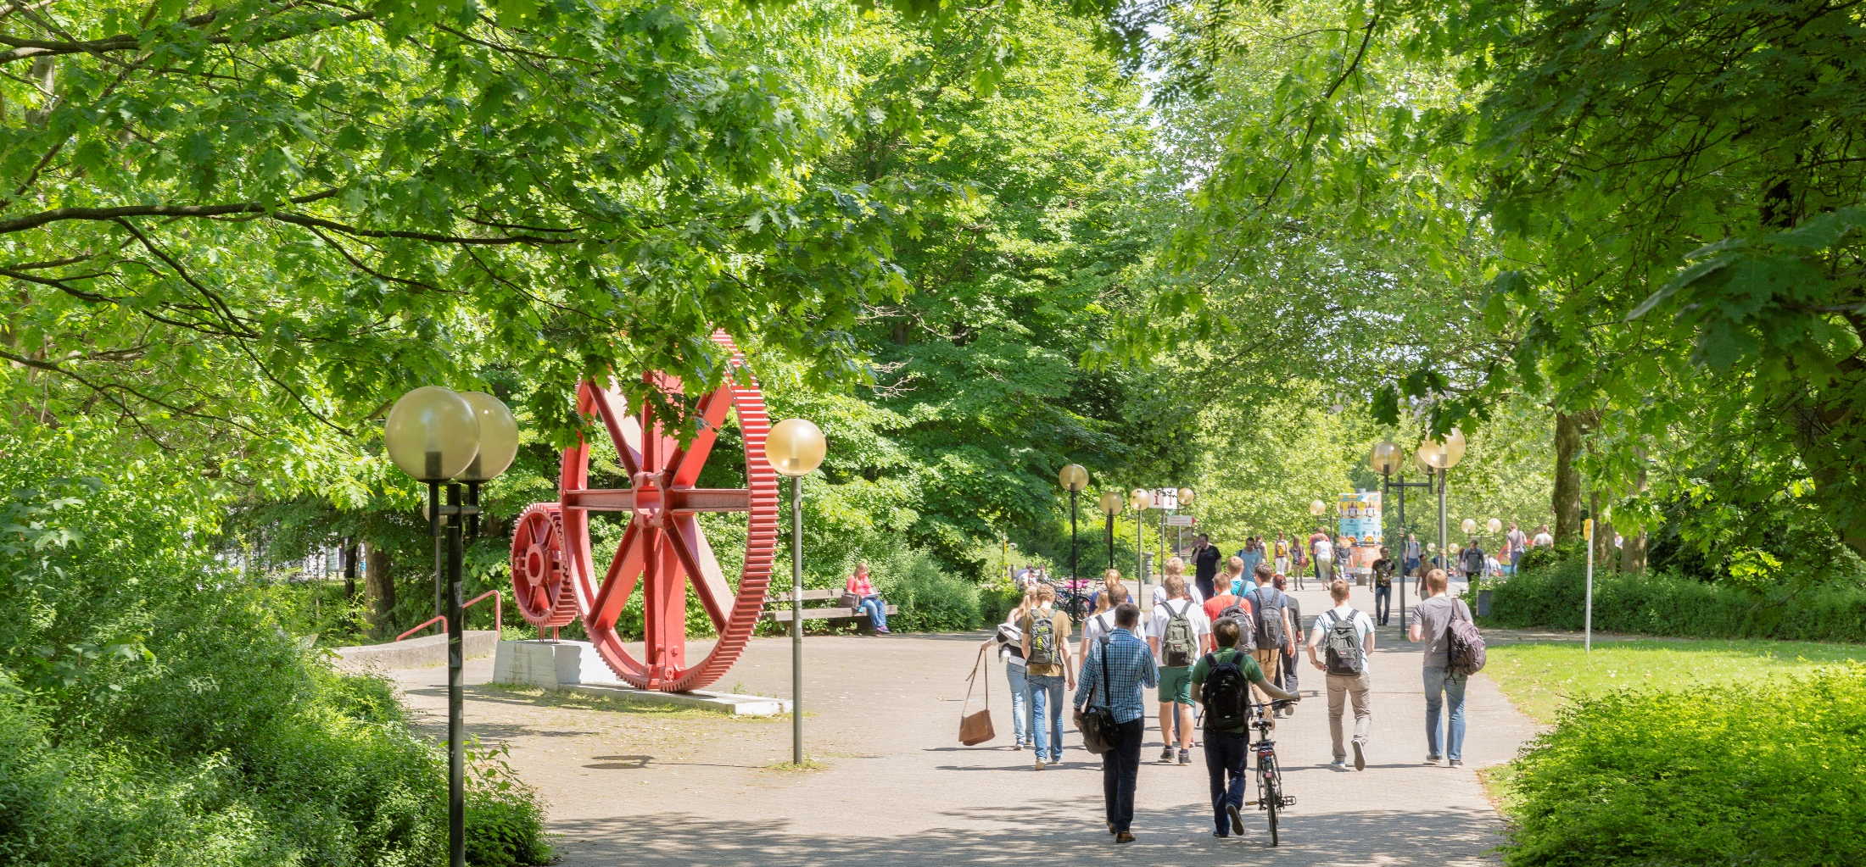
Be active on & off campus!
Join our university sports!
Over 75 differents sports and a fitness studio on campus
Choirs, big bands, orchestras - the musical life at TU is colorful
Get involved in our ensembles
TU Culture & fun in the city of Dortmund
Visit our downtown campus on the uni­ver­si­ty floor of the “Dort­mun­der U” Center for Arts and Creativity
Get free tickets for performances at the “Theater Dortmund”
Join many events in Dortmund and get tickets for a local soccer game of the BVB!
Photo credits: Roland Baege

Slide 10
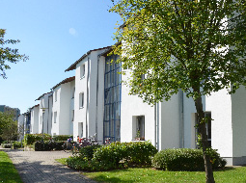
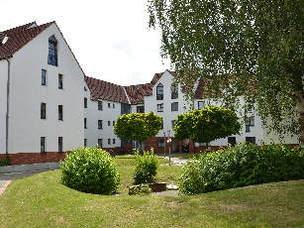
Photo credits: Studierendenwerk Dortmund
Living on campus & in Dortmund
Summer/Spring Semester: April - July Winter/Fall Semester: October - February (German Intensive Course March or September)
The university has its own subway stop approx. six minutes from downtown Dortmund
Student dorms on and off campus
Typically single rooms
Approx. 450 € / month
TU Dortmund University offers several cafés and student cafeterias Expenses for food: approx. 300 € / month
Subsidized meals in the cafeteria (lunch) from
1.50 - 4 € (entrée and sides), including vegan and vegetarian options, a grill counter, salad buffet and an à la carte warm/cold buffet
Bistros are open for breakfast and lunch
“food fakultät” is open for fresh pizza and pasta for lunch or dinner

Slide 11
We look forward to welcoming you
in Dortmund soon!
Photo credits: Roland Gorecki/Stadt Dortmund

