Slide 1
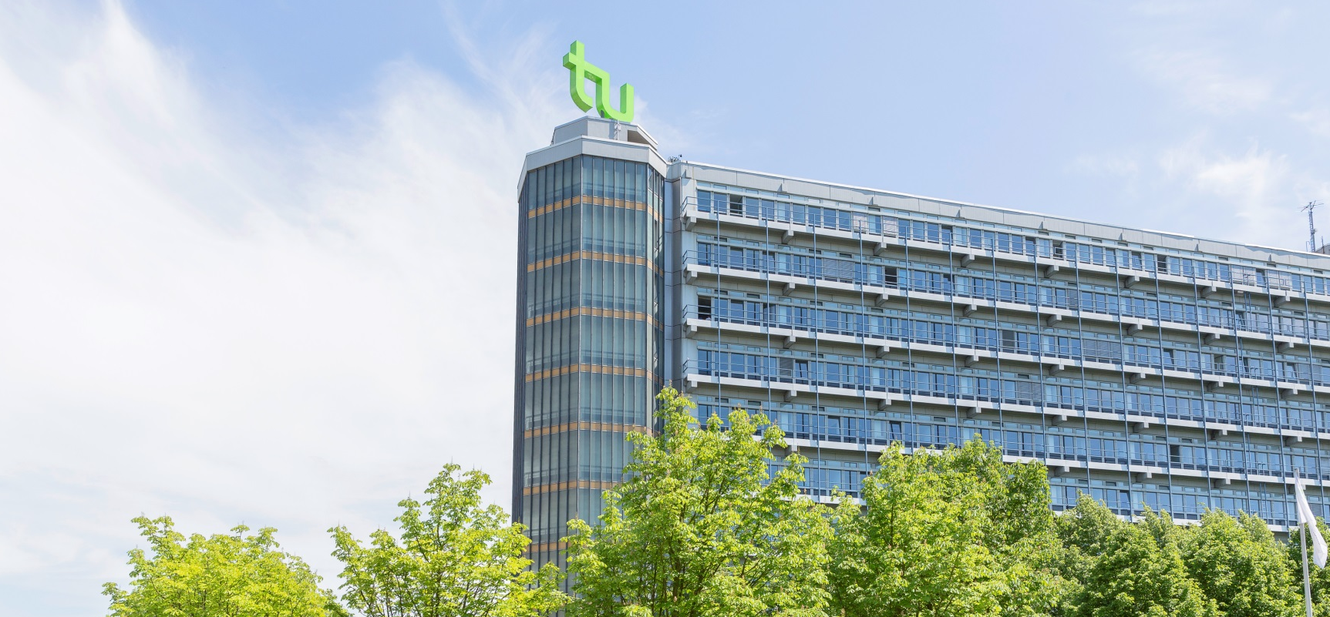
Photo credits: Roland Baege
Next ISP:
26 May until 29 July 2022
International Summer Program (ISP)
www.summerprogram.tu-dortmund.de

Slide 2
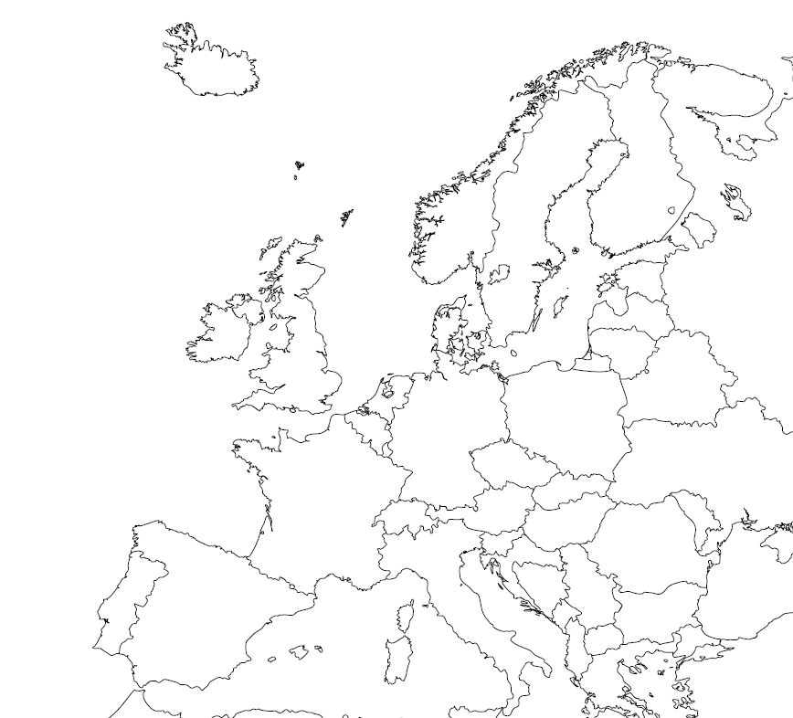
The Ruhr Area is Germany’s most densely populated area with almost 6 million people from over 150 nations
Benefits: safe environment, multicultural, relatively cheap cost of living, great location in Europe
Dortmund has nearly 600,000 inhabitants and a vibrant history
Dortmund

Slide 3
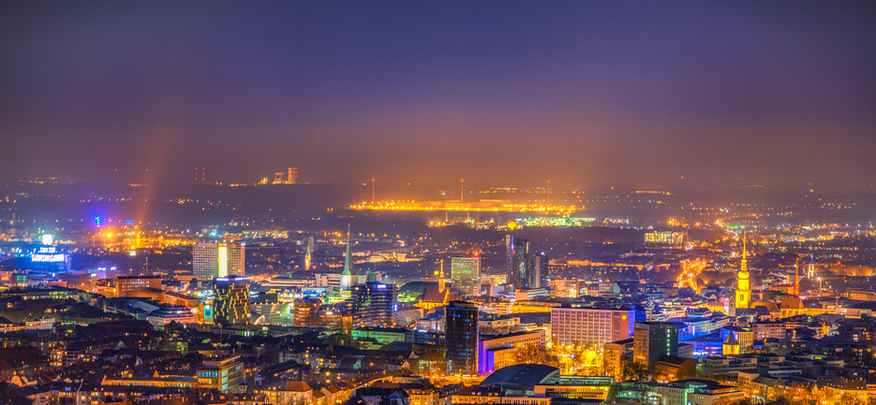
Photo credits: Michele Bergermann
Who are we?
We are Dortmund!

Slide 4
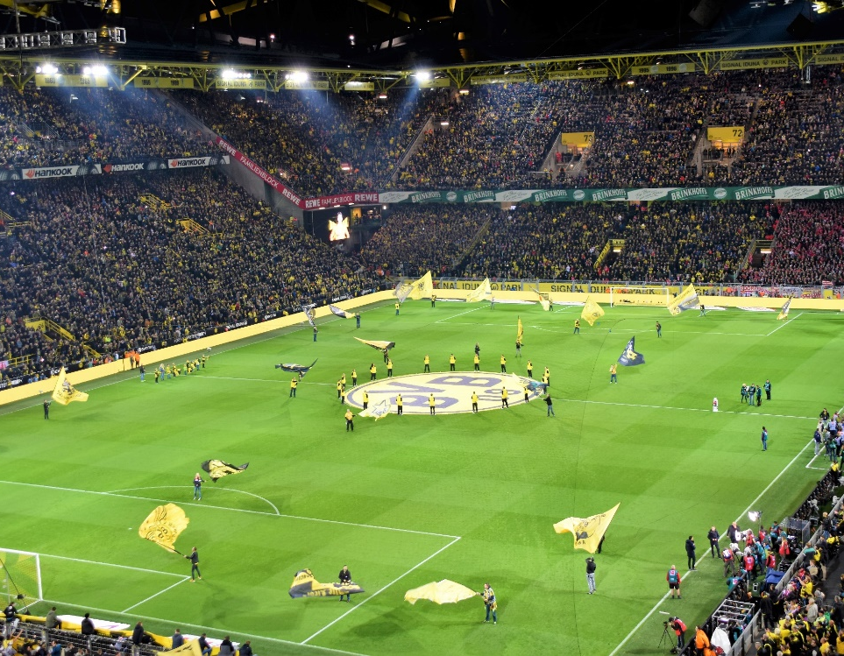
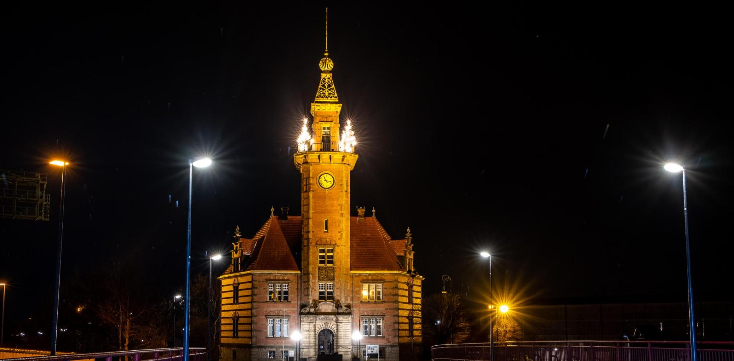
Photo credits: 30daysreplay Germany
Photo credits: Waldemar Brandt
Photo credits: Jonas von Werne
All of this is Dortmund
…and so much more!
Photo credits: Magnus Terhorst
Photo credits: Julian Guttzeit
Photo credits: Evgeni Tcherkasski

Slide 5
Photo credits: Jürgen Huhn
International Summer Program (ISP)
What is it about?
9-week summer study program from May 26th to July 29th 2022
Students are integrated in regular summer semester courses and campus life!
Courses taught in English

Slide 6
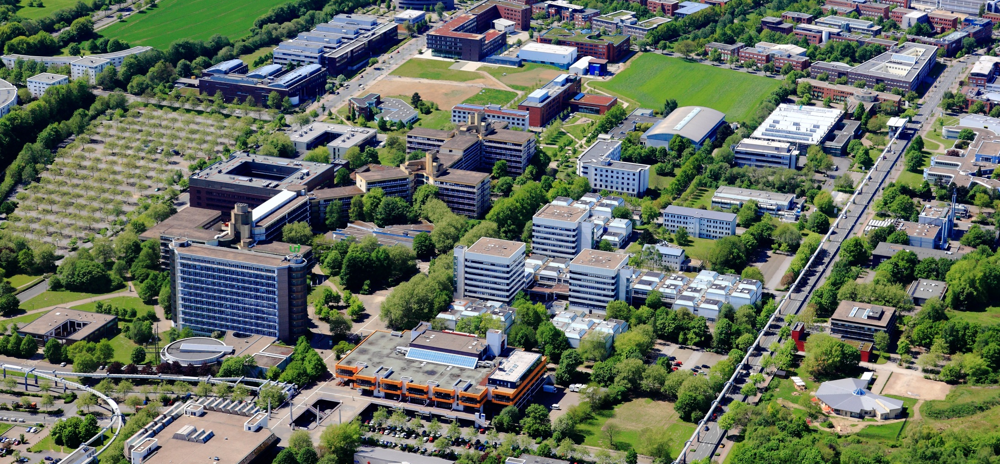
Tracks
Track A: Engineering
(Applied Mathematics, Automation & Robotics, Biochemical and Chemical Engineering,
Computer Science)
Track B: German Culture in European and Global Contexts
Track C: Entrepreneurship
(Entrepreneurship, Business & Economics)
… and much more
German language course, cultural program, excursions, research & study projects possible
Photo credits: Peter Sondermann

Slide 7
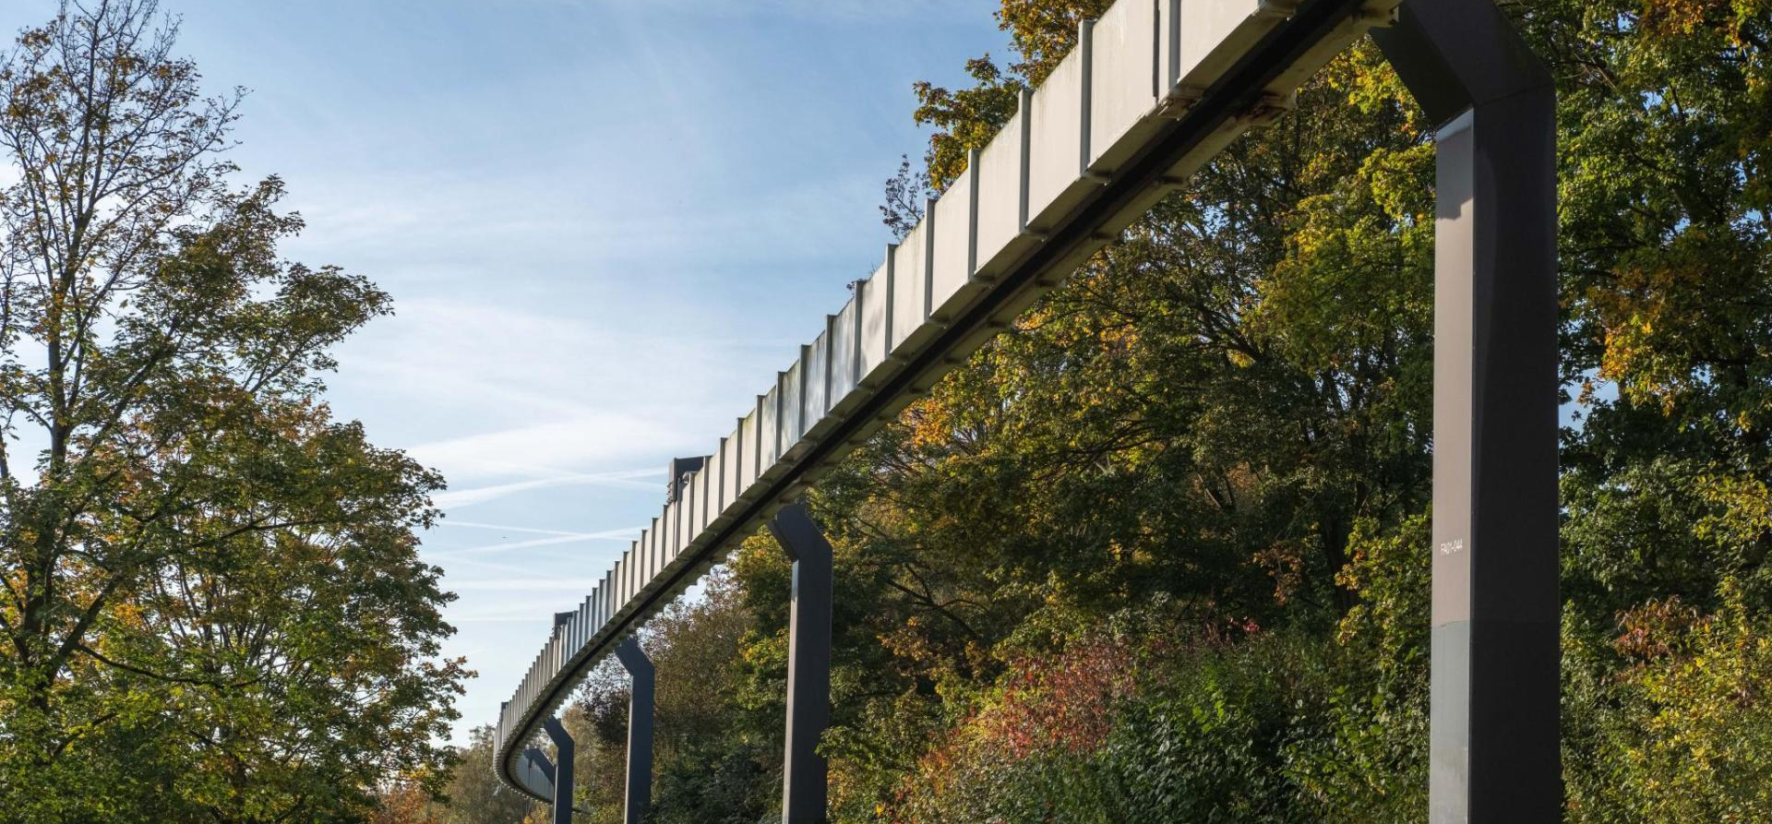
Photo credits: Magnus Terhorst
Research Project
Based on your interests
Full-time and part-time possible
Supervised by a professor or doctoral candidate

Slide 8
Photo credits: Silke Viol
Expenses
Academic and language courses are covered through the exchange agreement between the student’s home university and TU Dortmund University and the tuition that students pay there.
Mandatory service package (€ 1,950) includes
Accommodation (student residences)
Health insurance
Public transport ticket for the entire state (NRW)
Cultural program and excursions
Additional costs of living are approx. 250€ per month
Application
Online application deadline: 15 February 2022
Only possible for students from partner universities
You need to be registered at your home university and to be nominated by your study abroad coordinator via e-mail.

Slide 9
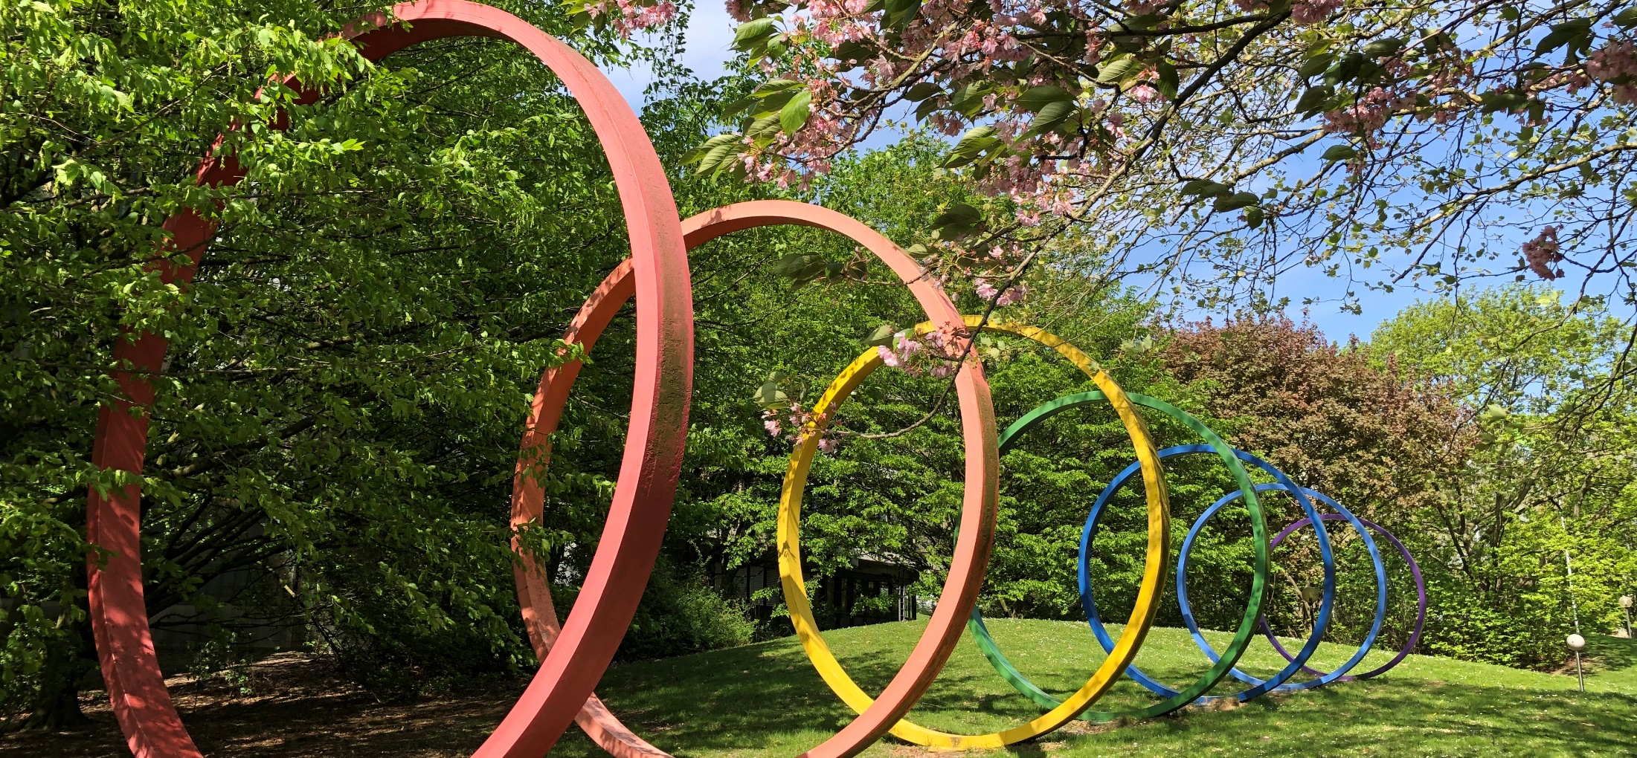
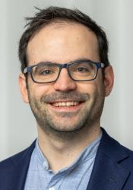
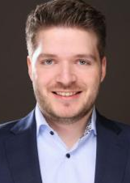
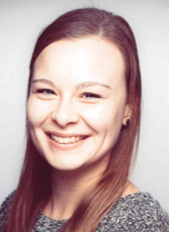
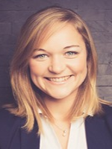
Photo credits: Lea Schubert
Meet the staff
Directors
Administration & Tracks
Prof. Dr.
Sergio Lucia
Prof. Dr.
Walter Grünzweig
Miriam Gothe
Administration
Lukas Lüken
Track A
Laura Kost
Track B
Katharina Weidemann
Track C

Slide 10
We look forward to welcoming you
in Dortmund soon!
Photo credits: Roland Gorecki/Stadt Dortmund

